Slide 1
NanoCreditAI
An AI-driven platform for secure nano-entrepreneur credit assessment.
Team Name -Byte_Me_BirulManMang

Slide 2
Table of contents
The Contemporary Problem and Relevance
Our Solution and Demo
01
02
Code Implementation
Uniqueness & Driving Factors
03
04
The difficulties faced by nano-firms in procuring loans
How NanoCreditAI comes to their rescue
It’s simple UI and set-up along with NCA’s seamless integrations
Why NCA is the Future ?

Slide 3
01
The Contemporary Problem and our Customer Base
What Banks are lacking that these nano entrepreneurs need ?

Slide 4
The Problem In Contemporary Approach
Alternative Data:
Custom Loan Products
Thin-File Customer Support
Scalability & Trust
Banks lack systems to assess creditworthiness using non-traditional data
Lack of tailored loans forces nano-enterprises to rely on informal lenders.
Existing models can't evaluate customers with limited formal records.
Present systems limit data sharing, reducing flexibility and trust with nano-entrepreneurs.

Slide 5
Our Vibrant Customer Base
1
Local Fruit Vendors, hawkers
Est. Income
Rs 15k-20k
4
Mobile Accessory Sellers
Est. Income
Rs 25k-30k
2
Local “Kirana” Stores and other small scale owners
5
Local Dairy Shops,
Est. Income
Rs 10k-18k
3
Market Stall Holders (Who move day to day)
6
Cobblers, Handicraft Makers

Slide 6
Our Solution and Demo
02
How NCA comes as a mediator ?

Slide 7
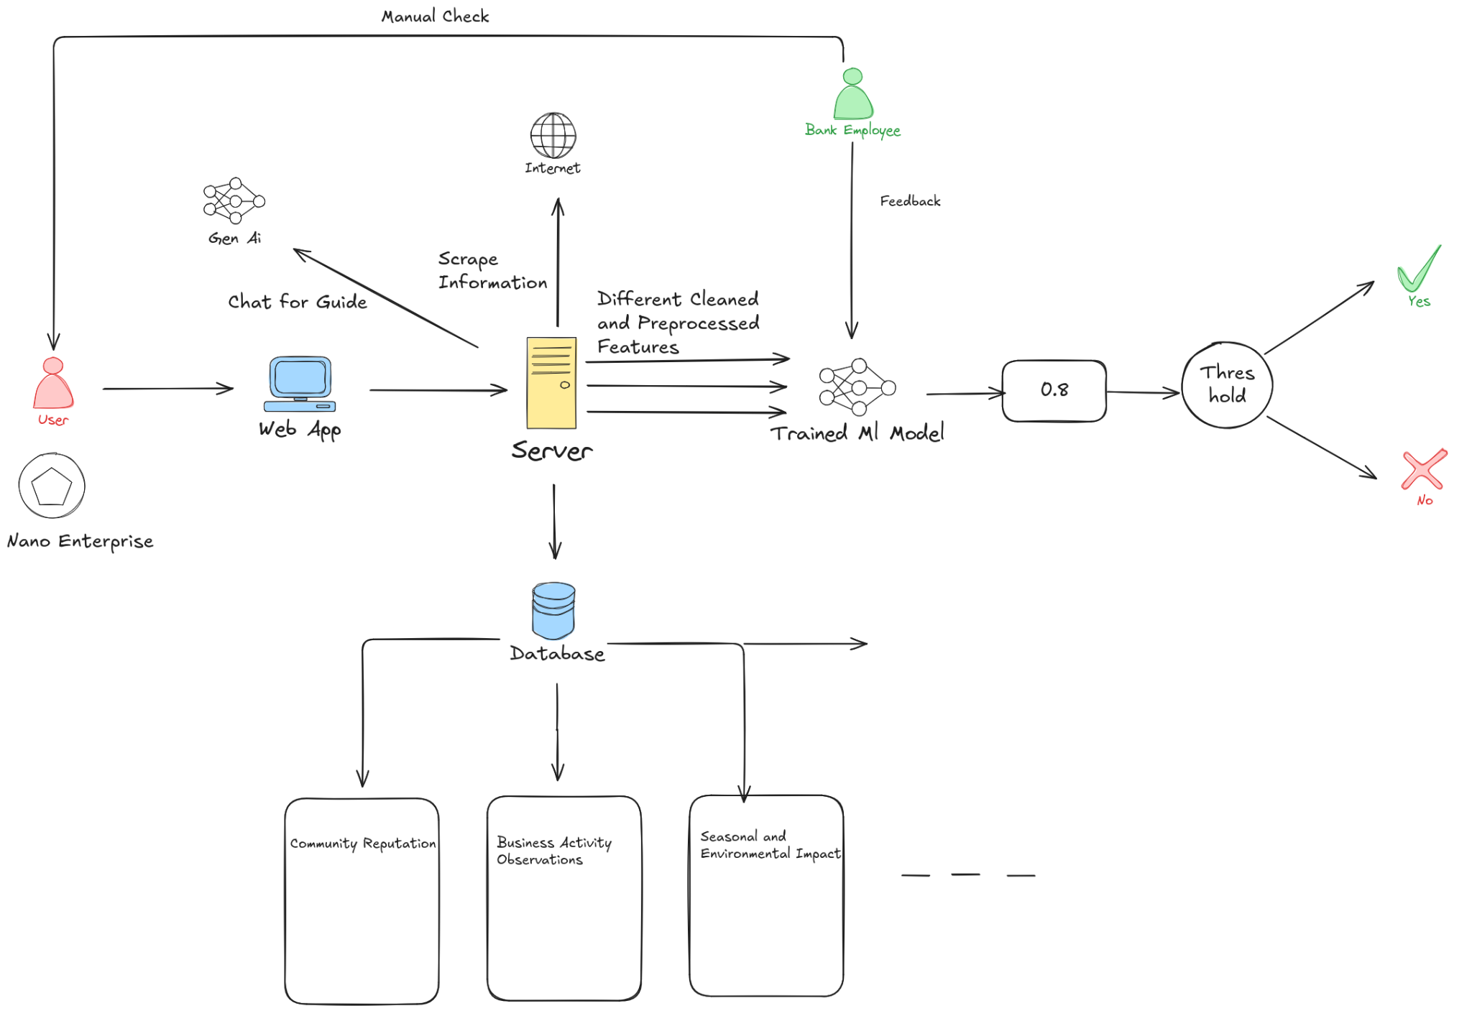

Slide 8
Creditworthiness Assessment Data Points
1
Community Reputation
7
Participation in Welfare Programmes
13
Observed Consistency
2
Business Activity Observations
Family and Dependents
Training and Skill Development
8
14
3
Informal Credit Relationships
Seasonal and Environmental Impacts
Debt and Liabilities
9
15
4
Asset Ownership
Behavioural Indicators
Savings and Insurance
10
16
5
Utility And Bill Payment Pattern
Business Location, Infrastructure
Collateral
11
17
6
Local Market Standing
Customer-Supplier Relationship
Amount Requested
12
18

Slide 9
Data Generated By Our Models
Creditworthiness
Trust Score
Business Performance
Loan History
Asset Ownership
Social Feedback
Assessment based on alternative data.
Transparency and engagement level
Income, cash flow analysis.
Informal credit and repayment trends
Identification of key assets.
Sentiment from community insights

Slide 10
Code Implementation
03
NCA’s Ready to use UI and a robust backend

Slide 11
Tech Stack
Frontend | Models | Backend
NEXTjs | OCR, VIT Models | FlaskAPI, Scikit-Learn, Faker
Tailwind CSS | XGBoost, LSTM, GRU | Google Maps API, Python 3.12
Shadcn | Gemini 1.5 Pro | Beautiful Soup, Selenium, Crypto

Slide 12
04
Uniqueness Of Our Idea, Future Of Banking
Why NCA is the future in this Nano Entrepreneurship

Slide 13
Uniqueness And Solution
The Differentiating Factors
Nano ID & Blockchain
Collateral Value Evaluation
Automatic Data Extraction using AI
The Unique ID will be a hash of the Aadhaar and 18 data points, stored on the blockchain for secure loan access. So that the other banks can access it easily then
It evaluates the collateral value by searching online to estimate the net loan cost, which is then provided to the bank.
Using OCR models and LLM we can extract different details of the user using medium like images, videos, receipts, docs etc

Slide 14


Expansion Of Customer Base
Scalability
Partnership Opportunities
Financial Literacy
It can reach unbanked and underbanked populations of rural and semi urban areas
Our model can adapt to various industries creating a sustainable framework
Collaboration with MFI’s can lead to a hybrid Banking Ecosystem
Using our robust chatbot we can educate these people

Slide 15
Thank You
Please keep this slide for attribution

